Slide 1
RestaurantAR: SE Perspective

Slide 2
Why RestaurantAR?
Due to the COVID-19 pandemic, restaurants have experienced never before seen changes
In order to enforce contactless rules, QR code scanning has already been implemented as a digital menu
However, there is a change to ‘spice things up’
Why not show the customer a cool AR model of the product?
They know how it looks like
It’ll make them more hungry
It brings a quirk to any restaurant
Notes:
Presented by Nick

Slide 3
Software Engineering Methodology
The chosen methodology for this project was agile development, or more specifically SCRUM
This is because it is highly flexible to variability in implementations, which is useful in a setting such as the restaurant industry
This COVID-19 pandemic has shown us how these set of businesses must adapt to a transformed world
Just like the industry changed, so must our development process to engage in what is needed, and what isn’t
Notes:
Presented by Nick

Slide 4
The Team
Team Leader: Nicholas Aksamit
Scrum Master: Michael Missana
Team Members:
Fahad Ansar
Karanjot Pabla
Michael Missana
Nicholas Aksamit
Paramvir Singh
Pranjelly Kathuria
Shivam Garg/Tyger Mascarenhus
Notes:
Presented by Nick

Slide 5
Sprint Format
Each sprint lasts one week
Daily Standup
Utilized Trello and Teams
Sprint retrospective: Tuesday at 11AM
Discuss work completed throughout the previous week
A four question format is proposed:
What went well?
What could have went better?
What are our roadblocks?
Suggestions for next sprint?
Sprint planning: Tuesday at 5PM
Discuss work to be completed upcoming week
School conflictions and time imbalance is raised
Notes:
Presented by Michael

Slide 6
Technologies Used
React Native
A platform for developing Android and iOS mobile applications using only one code base
It is highly flexible and allows installation of packages which extend the base features
JavaScript is the main language used, which is quick and easy to learn
Viro
Open-source platform for building AR applications
Enables the same positive features as React Native, since it’s used here
Microsoft Teams
For our weekly meetings, and notifications of work when it’s complete
Trello
A discussion board that allows for drag and drop management of project activities
MySQL
The database that holds information about reviews, dishes, and categories
Firebase
Google and Facebook authentication
Notes:
Presented by KJ

Slide 7
Sprint 1 & 2
Introductory sprints, to get familiarized with the framework to be used (React Native)
Initial database and codebase created, with REST API for communication
Expo was used initially, but was soon after downgraded to default React Native
Experimental AR resources were attempted (Expo, ARCore), but failed our needs
UI Meeting was held for overall design of application, along with what features and/or components may be required
Side menu elements established
Viro was inspected further for usability with the project
Notes:
Presented by Pranjelly

Slide 8
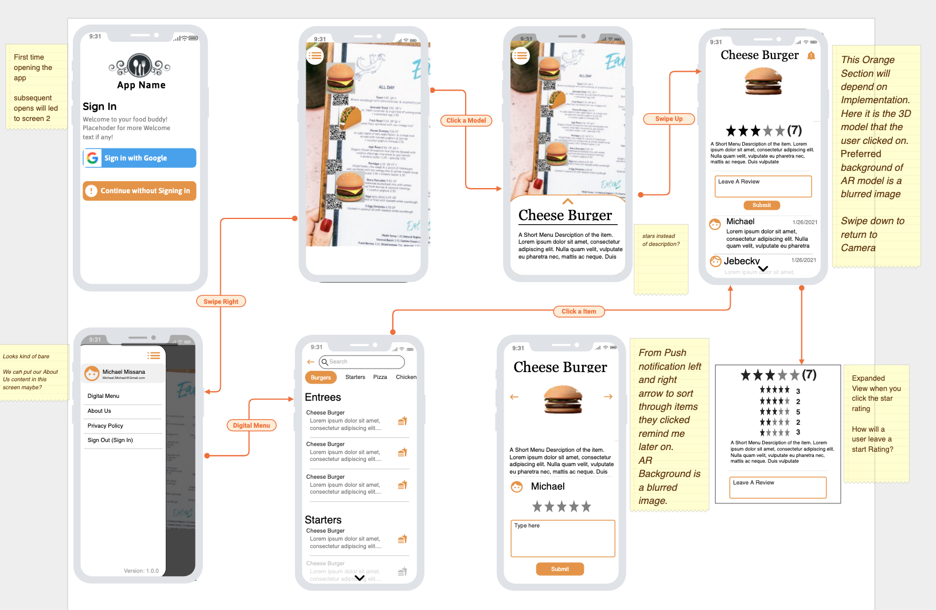
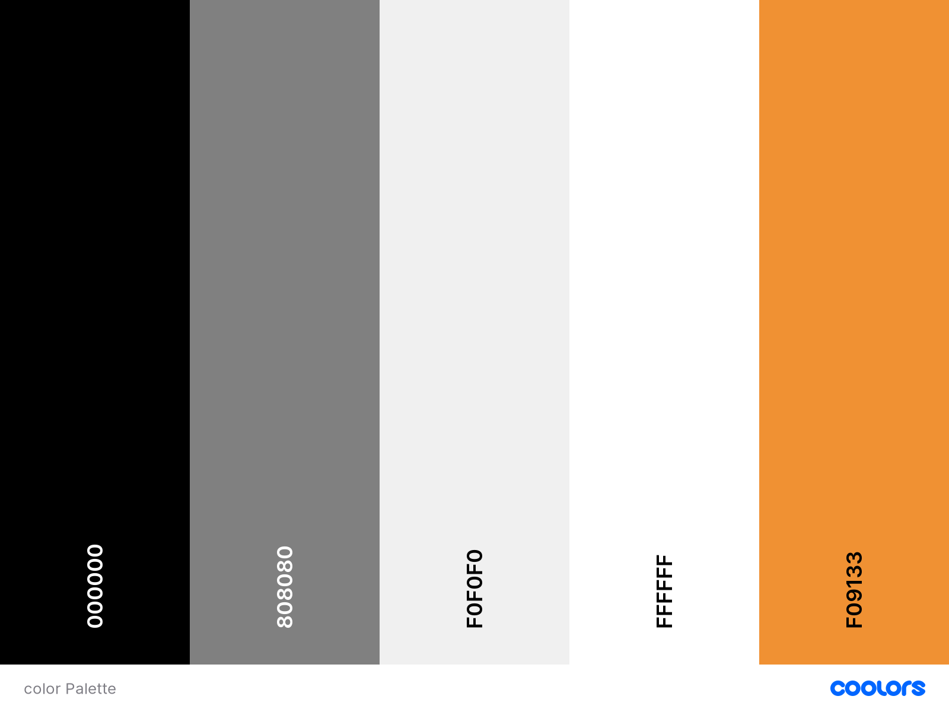
Initial UI and Colour Palette
Notes:
Presented by Michael

Slide 9
Sprint 3
Side menu, push notifications, and digital menu initialized
Digital menu was also completed fairly quickly
Side menu and push notifications require more work, with package issues arising from both
Work was continued on ViroAR and its feasibility, as well as implementation with the project
Back-end API initially complete, along with the database
The UI colour palette was standardized, easing further designs
Report 1 worked on and complete
Notes:
Presented by KJ

Slide 10
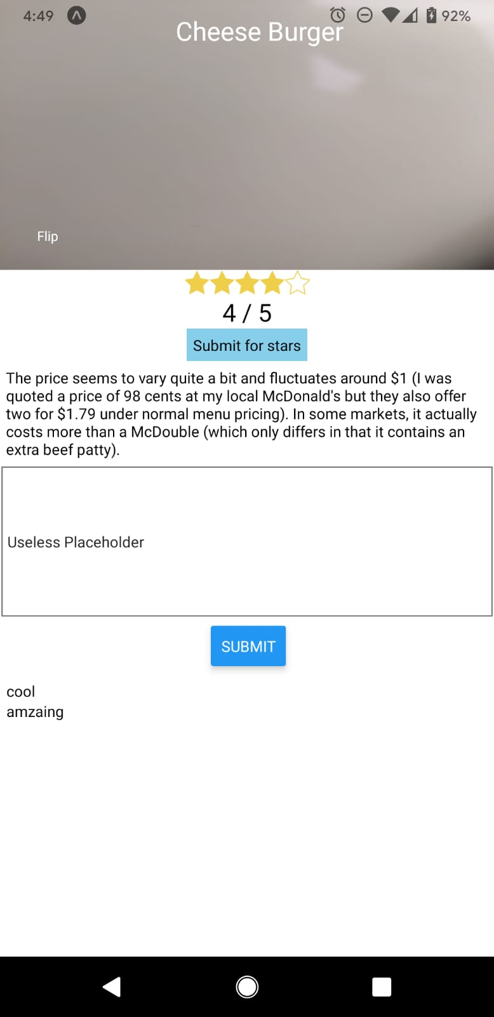
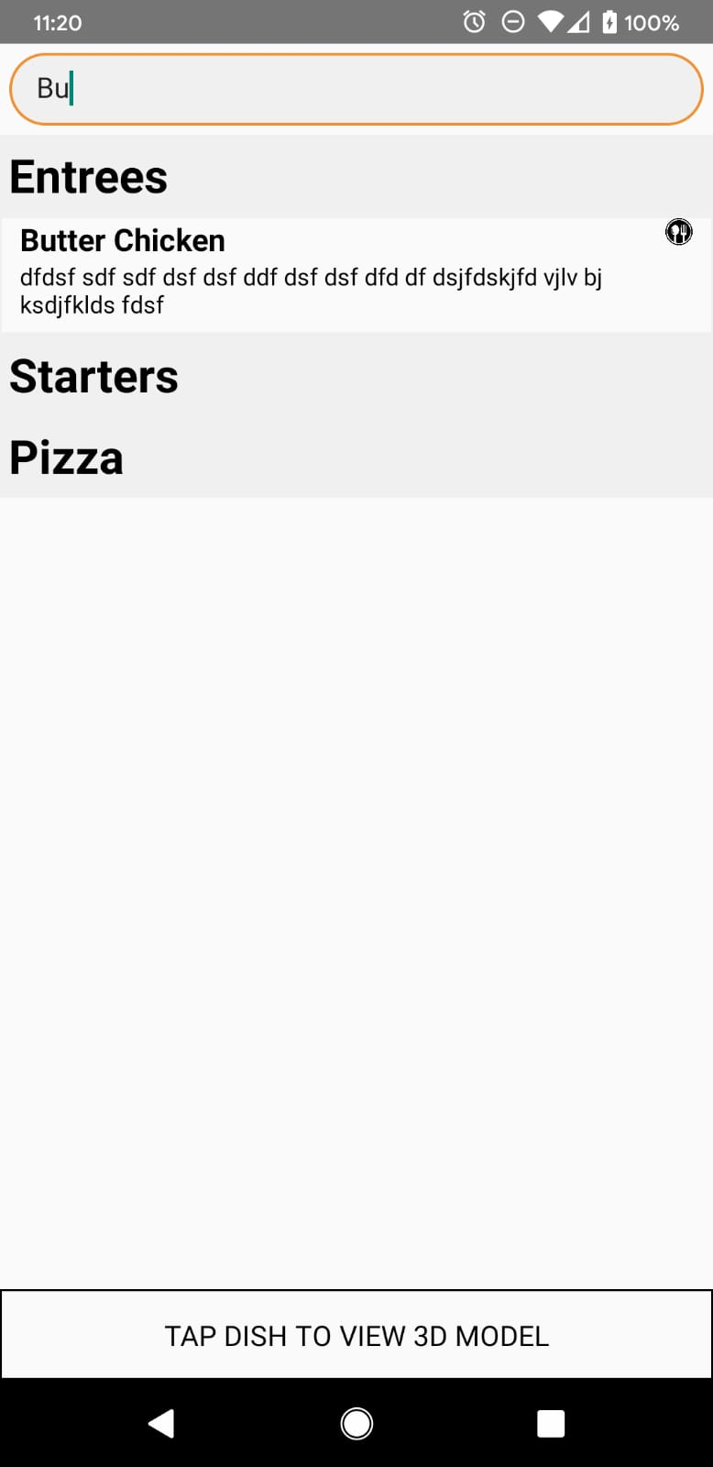
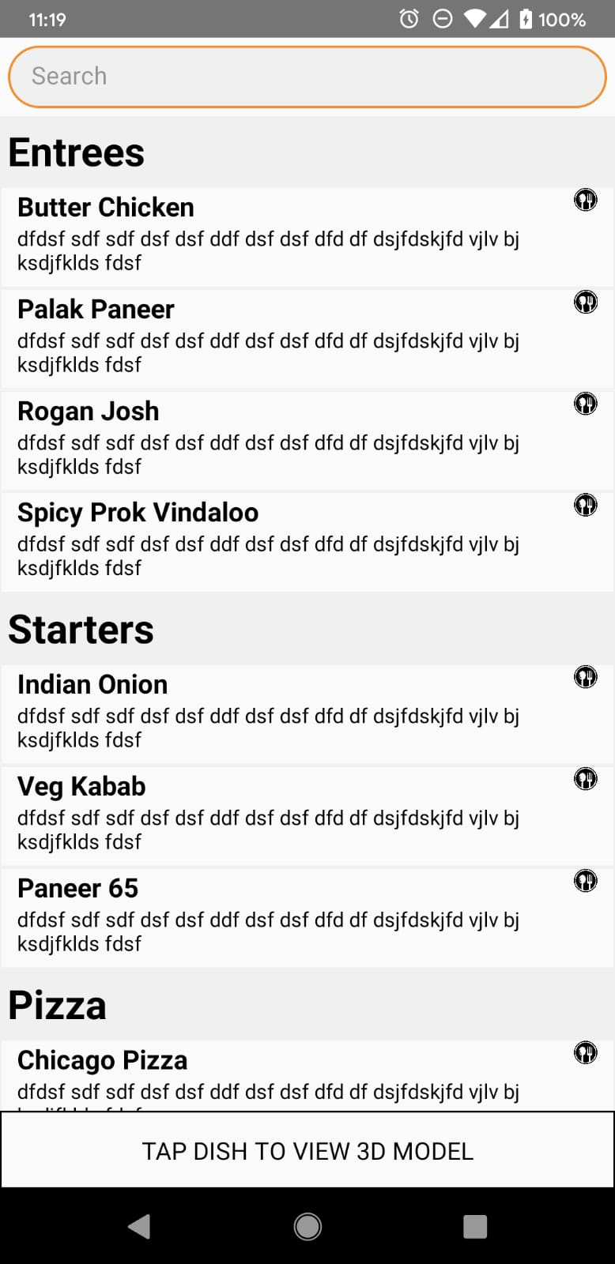
Release Images (up to this point)
Expanded Rating
Digital Menu
Notes:
Presented by Paramvir Singh

Slide 11
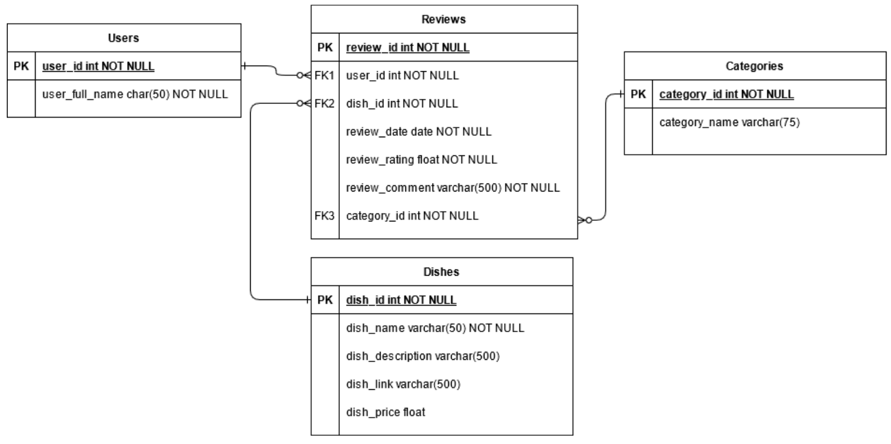
Initial Database Model
Notes:
Presented by Nick

Slide 12
Sprint 4-6
Android implementation of authentication initialized and completed (Google and Facebook)
Firebase used
Apple not feasible (costs money)
New codebase has become functional for iOS users
Viro worked on, repo branch created
Still has issues
Push notifications successfully initialized (and cleaned up) with no errors
Full item screen implemented
Side menu on pause because of Viro work
Back-end API insertion of review and authentication complete
Fullscreen review initialized
Notes:
Presented By Fahad
As we reached to sprint 4 ..

Slide 13
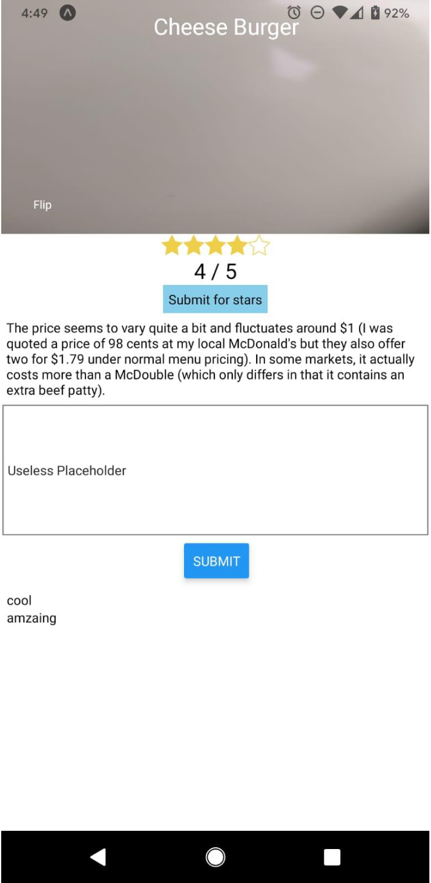
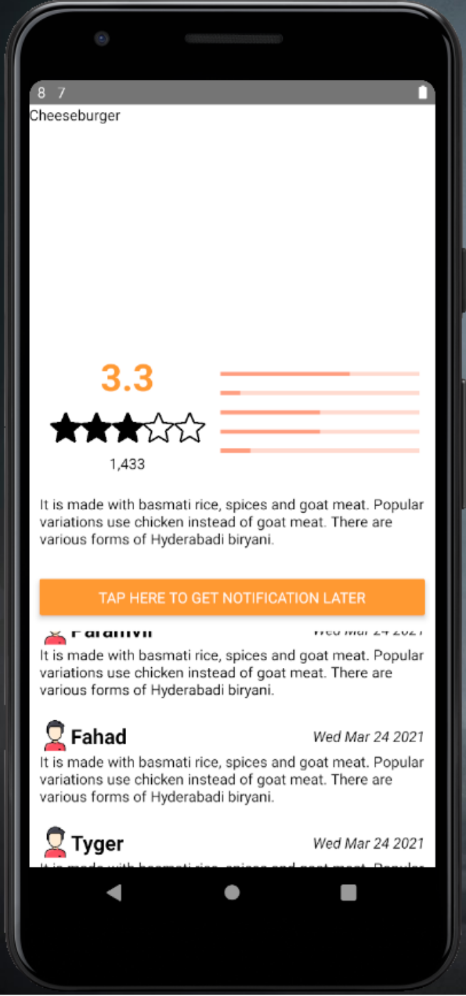
Full Item Screen
Old (Left)
New (Right)
Notes:
Presented by Paramvir Singh

Slide 14
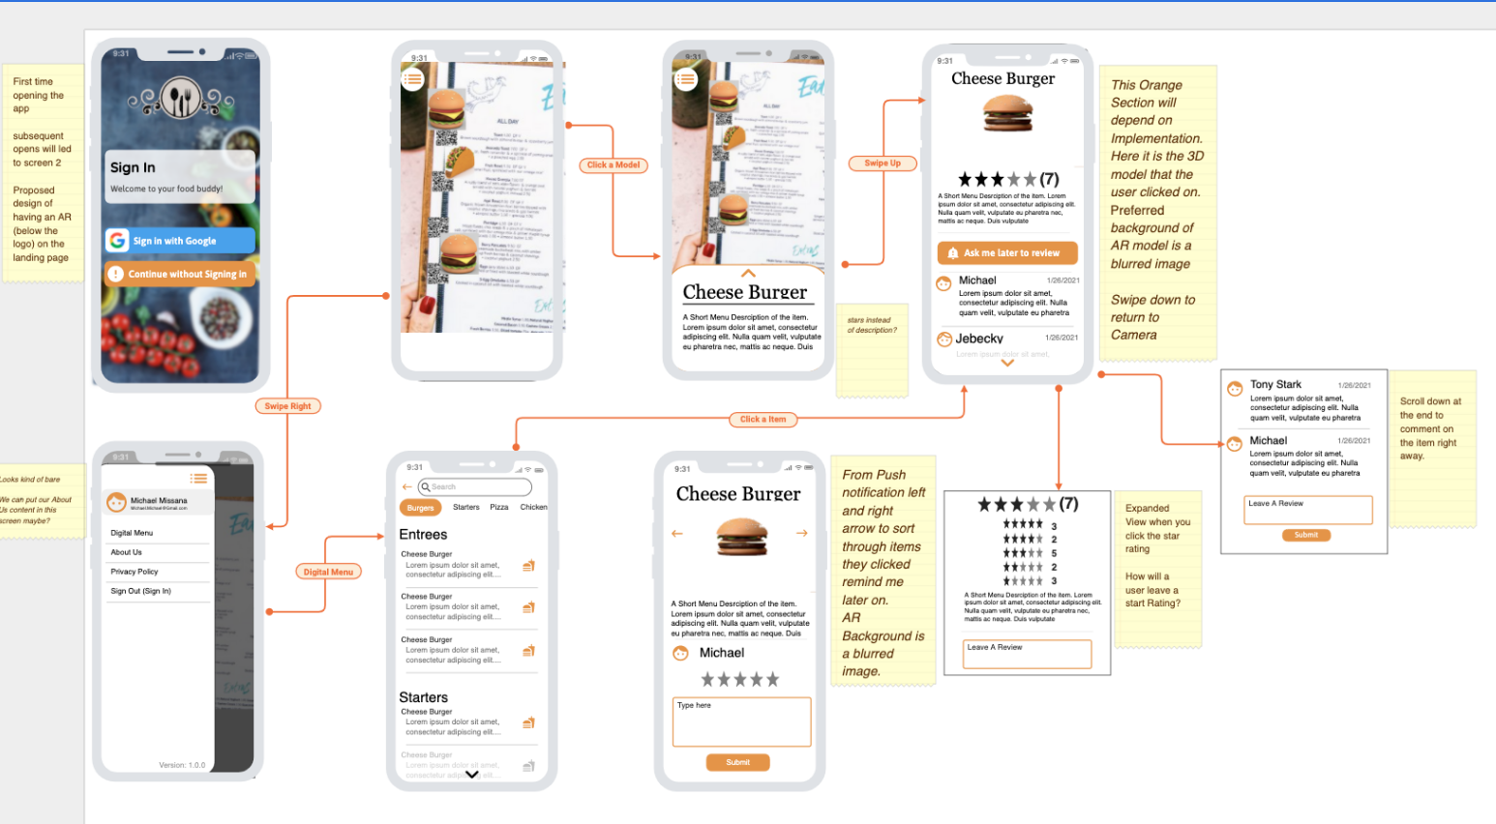
UI Design
Old (Left)
New (Top)
Notes:
Presented by Michael

Slide 15
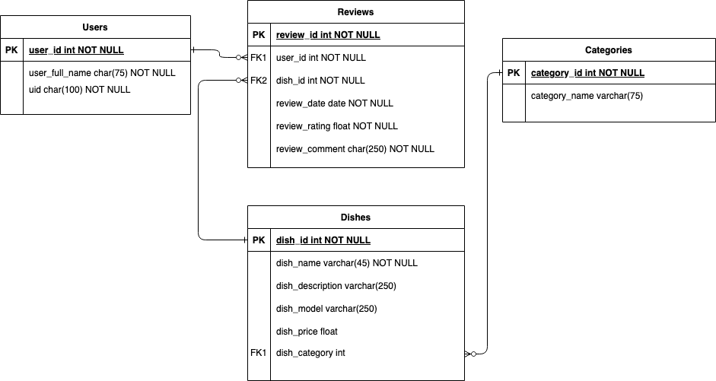
Database Model
Old (Left)
New (Top)
Notes:
Presented by Nick

Slide 16
Sprint 7-9
Redundant branches truncated
Blank application uploaded to Google Play Store
Side menu component still has errors
Push notifications merged into main branch
Pulling from database for digital menu complete
Full item screen and digital menu linked together
YouTube implementation for full item screen initialized and complete
Report 2 created, and complete
Viro work progressed (still has errors)
Fullscreen review component completed (but unlinked)
Styling of application modified to fit UI design more
Presentation created
Notes:
Presented by KJ

Slide 17
Sprint 10-11
Google and Facebook authentication merged
Merge of full item screen with digital menu functionality into main branch
Notifications modified to review in two hours after button press (on FullItemScreen)
Full review screen linked with application
Android QR code scanning implementation complete, and merged
AR work progressed
Presentation work continued, and complete
Slight back-end changes for insertion of review
Side drawer menu, and full login screen discontinued
Presentation complete
Notes:
Presented by Tyger

Slide 18
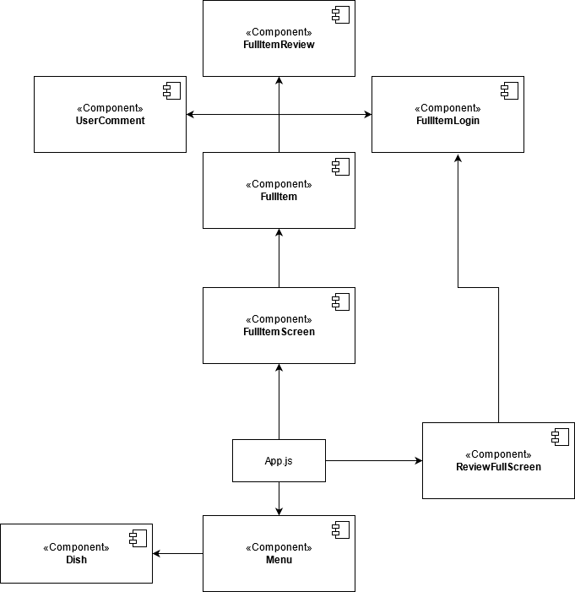
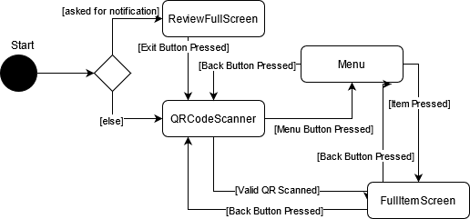
Final Component/Overall
State Diagram
Starting Point: App.js
Notes:
Presented by Tyger

Slide 19
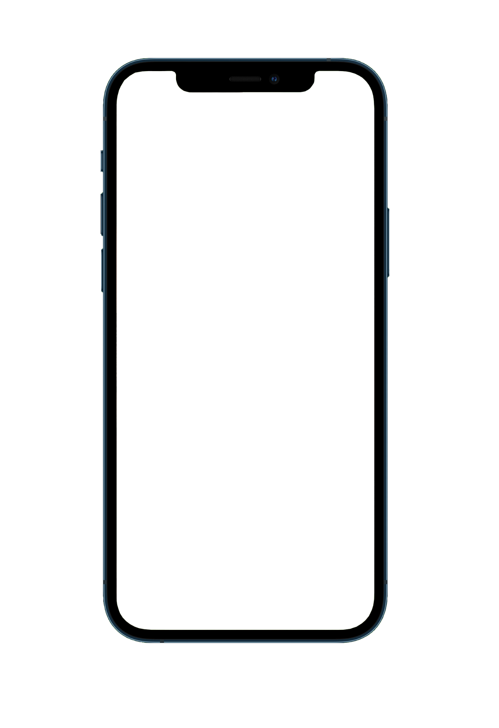
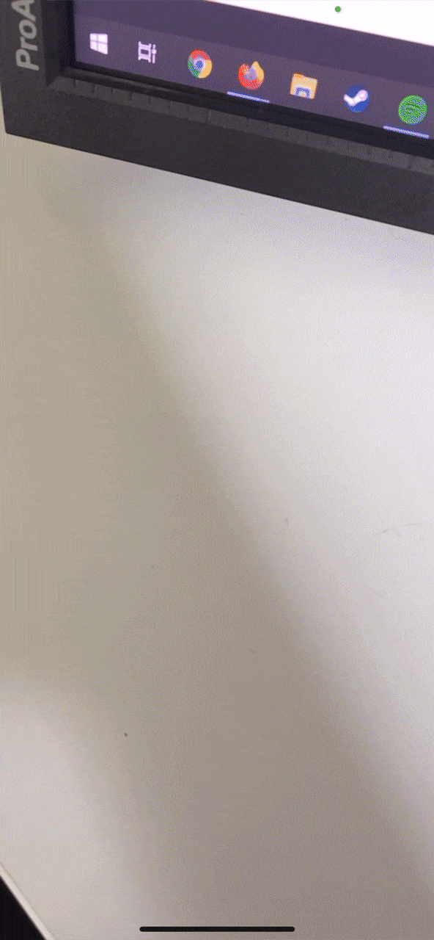
AR
Viro for React was used for AR implementation(*)
We can place AR image trackers on a physical menu
Our camera looks for these markers and places a 3d model in relation to these AR image trackers
Free use models were obtained from Google Poly,
although a real world application would require custom modeling
Our 3D models consist of
obj file the actual 3D model
mtl file a material file for mapping texture
png file for colour mask of our object
Notes:
Presented by Michael

Slide 20
Developmental Issues
Difficult to manage time online with the COVID-19 pandemic, alongside other courses
Finding the AR platform and implementing it in the project
Unknown if both iOS and Android would be supported
Authentication delayed because of this
Side drawer menu gave unknown errors
Communication would lower as school became busier
Testing for iOS requires a Mac device
Some packages would conflict
Notes:
Presented by Pranjelly

Slide 21
Learned Aspects
Packages make implementation easier, though can also complicate the process with inter-package conflictions and version mismatches
Communication in a group setting is essential
Periods where contact was high: team morale and work velocity were increased
Vice versa for low contact
Splitting of components in development allows for easier visualization of the code
For a project such as this, heavy documentation was not needed, as a compartmentalization technique is used
Notes:
Presented by Fahad
Packages make life easier but sometimes everything can collapse due to version mismatches, interpackage conflictions
There were multiple dependencies for some packages and those dependencies has complications

Slide 22
Any Questions?
Notes:
Prseneted by Nick

